Slide 1
Nanoscale Grain size Meas.
경북대학교 MENLAB 2025000422 최민수

Slide 2
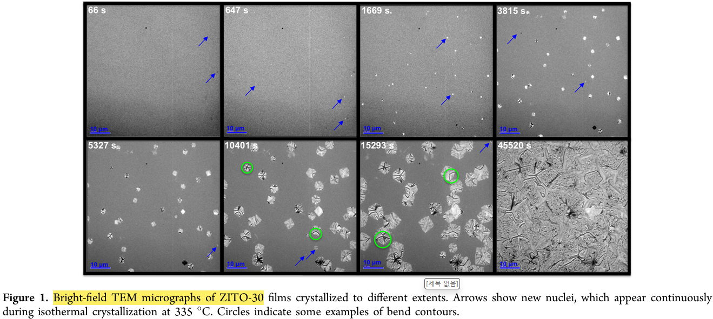
In Situ Crystallization and Morphological Evolution in Multicomponent Indium Oxide Thin Films
■ Method: Bright-field TEM (2017년 논문)
Cryst. Growth Des. 2017, 17, 1396−1403

Slide 3
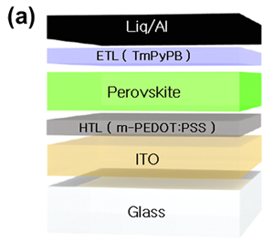
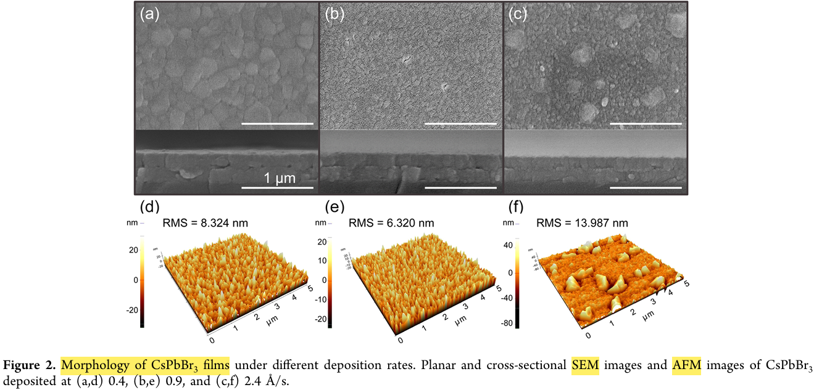
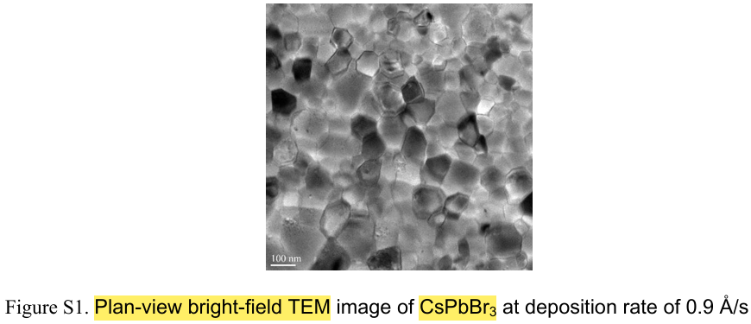
Modulation of Growth Kinetics of Vacuum-Deposited CsPbBr₃ Films
for Efficient Light-Emitting Diodes
■ Method: SEM, Plan-view bright-field TEM (2020년 논문)
ACS Appl. Mater. Interfaces 2020, 12, 1944−1952

Slide 4
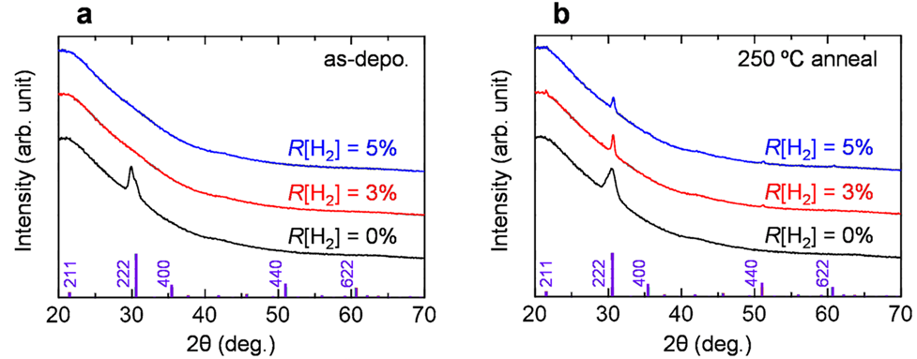
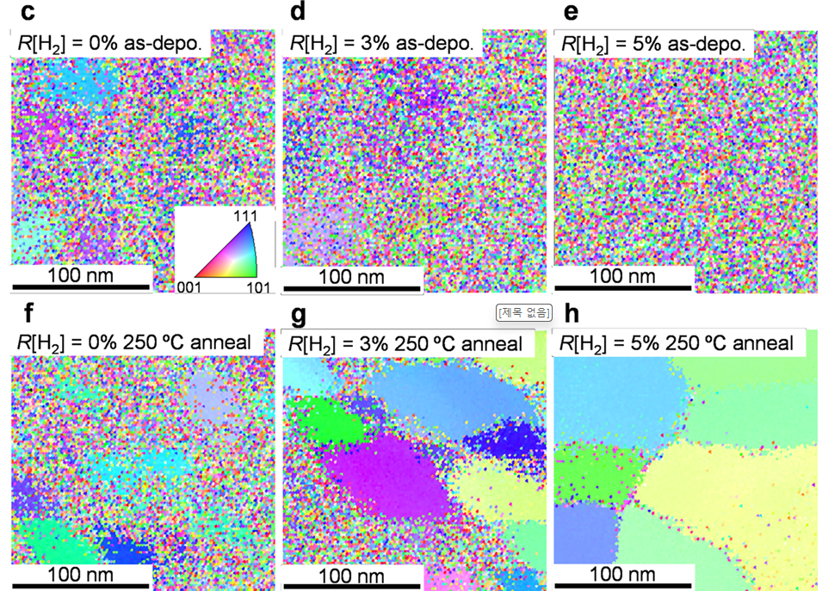
Super Strengthening Nano-Polycrystalline Diamond through Grain Boundary Thinning
■ Method: XRD, EBSD (2022년 논문)
NATURE COMMUNICATIONS| (2022) 13:1078

Slide 5
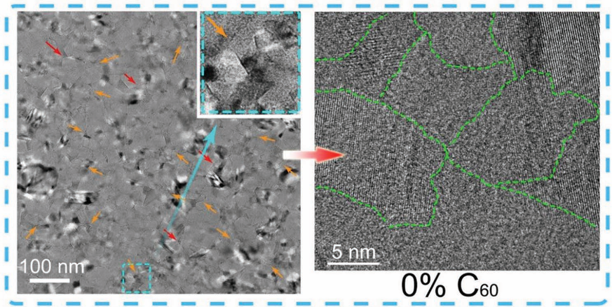
Super Strengthening Nano-Polycrystalline Diamond through Grain Boundary Thinning
■ Method: HRTEM (2023년 논문)
Adv. Funct. Mater. 2023, 33, 2214696

Slide 6
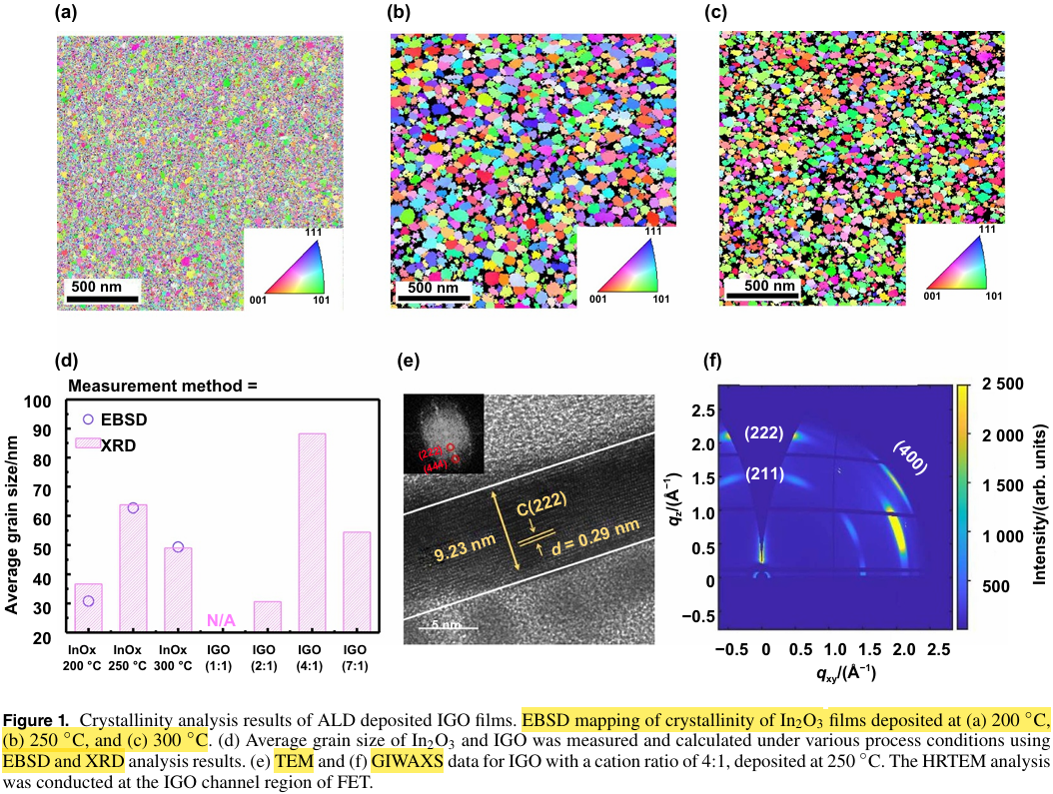
Tailoring the number of lines for IGO-channel 2T0C DRAM comparable to conventional 2-line operation 1T1C structure for ...
■ Method: EBSD, XRD (2025년 논문)
Int. J. Extrem. Manuf. 7 (2025) 055503

Slide 7
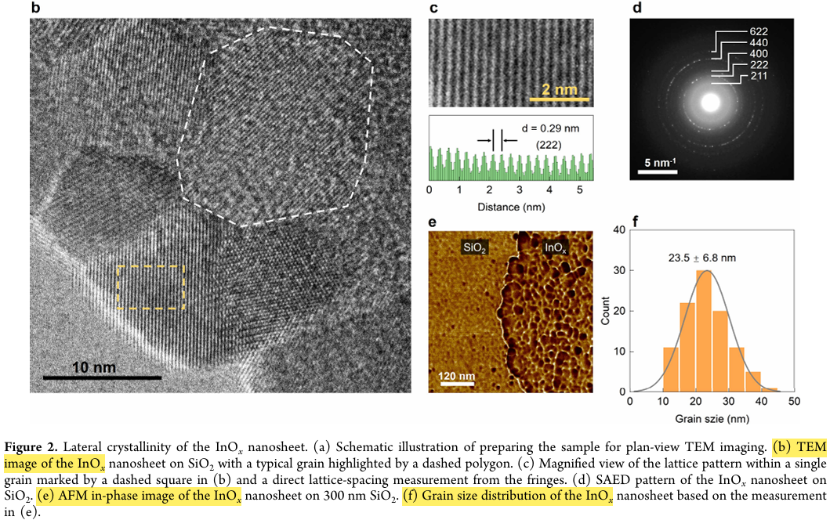
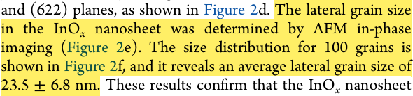
High-Mobility Indium Native Oxide Transistors via Liquid-Metal
Printing in Air
■ Method: TEM, AFM in-phase image (2026년 논문)
ACSAppl.Mater. Interfaces2026,18,22089−22101

Slide 8
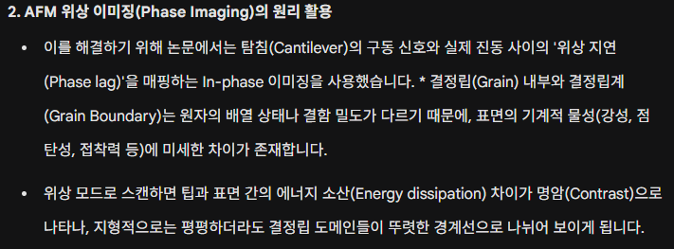
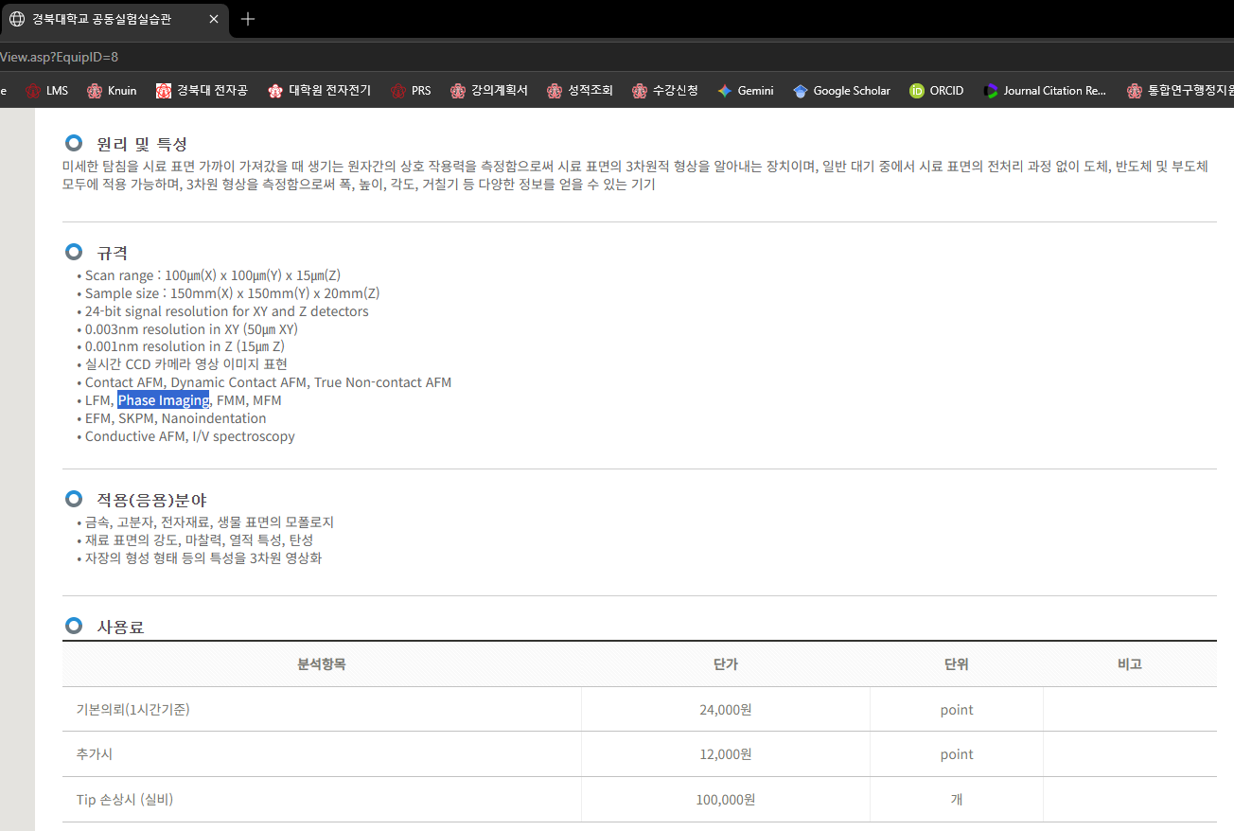
High-Mobility Indium Native Oxide Transistors via Liquid-Metal
Printing in Air
■ Method: TEM, AFM in-phase image (2026년 논문)
ACSAppl.Mater. Interfaces2026,18,22089−22101

Slide 9
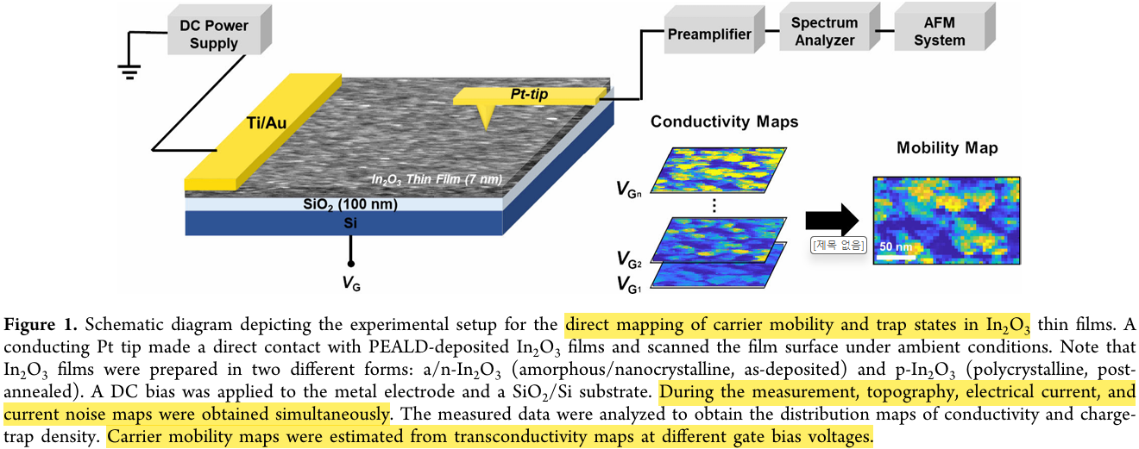
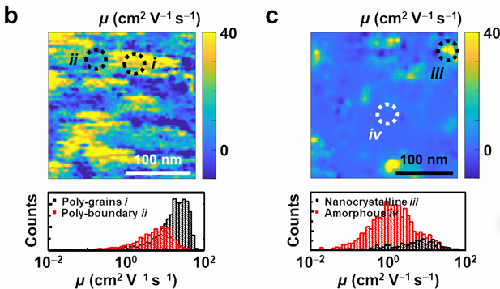
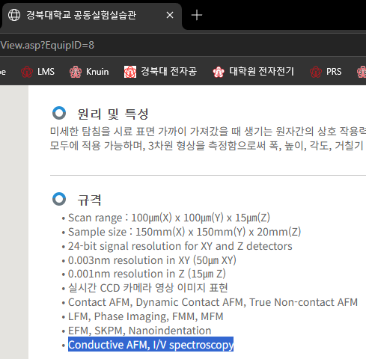

Direct Mapping of Crystallization-Induced Trap-State Modulation
and Its Impact on Local Carrier Mobilities in Indium Oxide Thin-Film...
■ Method: Conducting AFM (2026년 논문)
NanoLett.2026,26,3434−3442

Slide 10
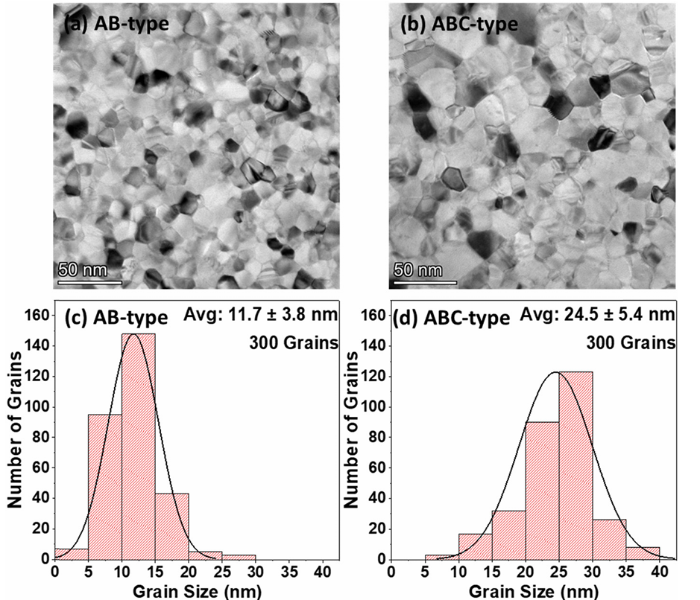
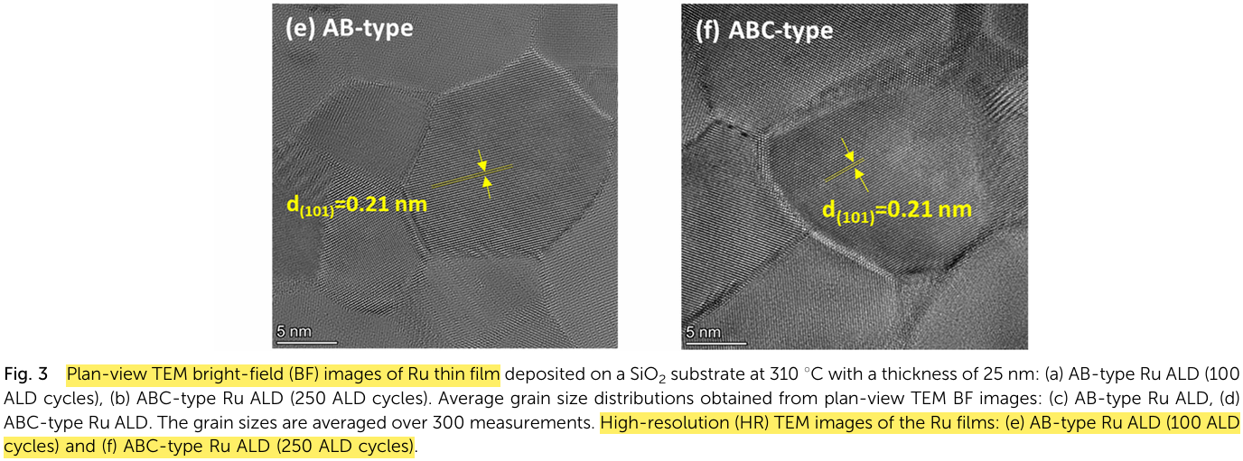
Enhanced functional properties of ABC-type atomic layer deposited Ru thin films for advanced Cu alternative nanoscale interconnects
■ Method: Plan-view bright-field TEM, HRTEM (2026년 논문)
J. Mater. Chem. C, 2026, 14, 7607–7618

